Slide 1


STAT 3011
Group 10
March 26, 2024
Credit
Risk Analysis
Notes:
Good afternoon. We are group 10 and today we are going to talk about the machine learning project with topic of credit risk analysis.

Slide 2

STAT 3011
Table of Contents
March 26, 2024
Goal of our project
Explanation of our objective
Original Notebook replication
Exploratory data analysis, modeling, and evaluation
Improvements
Add additional improvements based on original notebook
Apply on external data
Apply best approachment and model to external data
TABLE OF CONTENTS
Conclusion
Elaborate the methods, scores, and limitation
Notes:
Here’s our project’s table of contents. The order of the presentation will be the goal of our project, explaining the original notebook replication, improvements, applying on external data, and conclusion.

Slide 3

STAT 3011
Project’s goal
March 26, 2024
What is Credit Risk?
: Credit risk is the probability of a financial loss resulting from a borrower's failure to repay a loan. It is the risk that a lender may not receive back the owed principal and interest.​
You became a lender
Your friend became a borrower
He could not repay to you on time
Had a Bad Creditworthiness
Lend your friend $1000
Was not able to repay the money to you at the end
Financial Loss
Notes:
So, what is credit risk? For example, when one of your friend borrows 1000 dollars from you, you become a lender and you friend becomes a borrower. If your friend can not repay to you on time, you can say that he had a bad creditworthiness. Also, if he is not able to repay the money to you at the end, you would face a financial loss. So in our daily life , even tho we're just having a small scale of transaction, credit risk already exists. ​

Slide 4
STAT 3011
Project’s goal
March 26, 2024
Why is it important?
Credit risk is common in financial institutions.​
Whenever we engage in financial activities, credit risk becomes an integral factor to consider. ​
If there is no any regulation and monitoring, a huge financial loss would be occurred. ​
​
This drive our credit risk analysis.​
​
Notes:
In real society, credit risk is even more common in financial institutions like banking or insurance companies. Whenever we engage in financial activities, credit risk becomes an integral factor to be consider. If there is no regulation and monitoring, a huge financial loss would occur. That's why we would like to draw you attention to the credit risk analysis.

Slide 5

STAT 3011
Project’s goal
March 26, 2024
Loan Default Classifier
Thousands of loan applications need to be approved by the bankers every day. The approval time of loan applications could be relative long. Reduce the bank profits due to the long operation time
Apply machine learning models to the historical data to build up a loan default classifier
Screen out the high-risk loan application
Expected influences
Reduce the approval time of applications
Reduce the pressure for the bankers
Reduce the employment cost
Notes:
Normally, the potential clients need to wait for a long time to get their money, also the long operation time can reduce the bank profits for counting the loan interest.​
Therefore, our group would like to apply machine learning models to build up an loan default classifier to screen out the high risk loan applications. We aim to reduce the approval time of applications, the pressure of bankers and employment cost.

Slide 6

STAT3011
March 26, 2024
Project
Replication
Notes:
Now, we’re going to represent the credit risk project’s original replication.

Slide 7
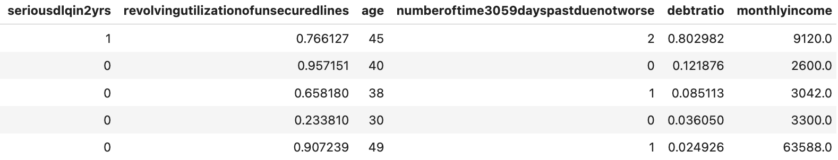
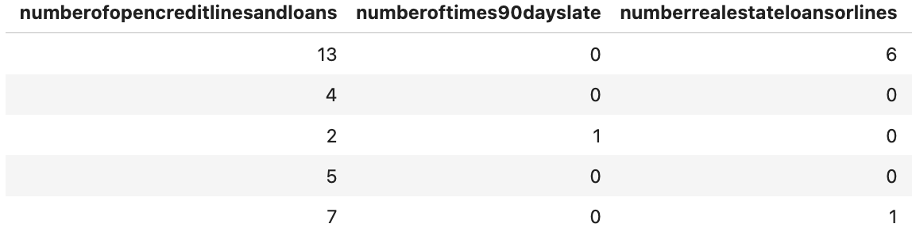
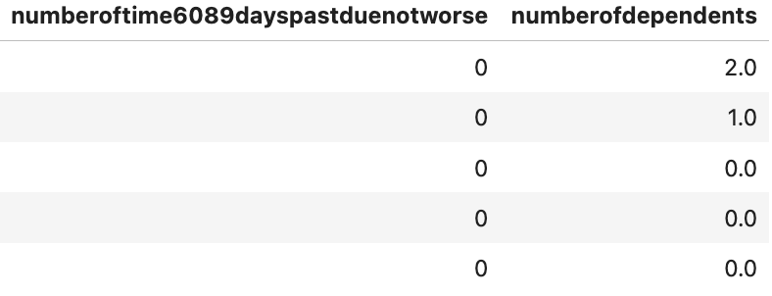
STAT3011
project replication
March 26 , 2024
Data overview
STAT3011_2324_GP10/Kelvin/stat3011 project2 eda p1.ipynb/line21
Data Source: data from book ‘machine learning solutions’
Row : 150000
Variables: 11 ( 10 predictor variables + 1 response variable)
Each Data: the demographic of a person (e.g., ages,monthly_income, records of late payment, etc..)
Notes:
In our project, we mainly used the dataset from the machine learning solutions with the topic of credit risk analysis. This dataset have 150 thousands rows with 11 variables. Among them, 10 are predictor variables and 1 is response variable, whether the individual is being default. Each columns show the demographics such as age, monthly_income, records of late payment.
[Doc]
STAT3011_2324_GP10/Kelvin/stat3011 project2 eda p1.ipynb/line21

Slide 8
STAT3011
project replication
March 26 , 2024
Feature Explanation
seriousdlqin2yrs: ‘Yes’ if the borrower has experienced past dues of more than 90 days in the previous 2 years; ‘No’ otherwise
revolvingutilizationofunsecuredlines: credit card limits of the borrower after excluding any current loan debt and real estate
age: borrower’s age
debtratio: (debt+expenditure)/monthlyincome
monthlyincome: value of the monthly income of borrowers
numberofopencreditlinesandloans: the number of open loans and/or the number of credit cards the borrower holds
Notes:
Here are the variables in the dataset, those which are more related to EMI are:
serious dlq in 2yrs
revolving utilization of unsecured lines

Slide 9
STAT3011
project replication
March 26 , 2024
Feature Explanation
numberrealestateloansorlines: the number of loans the borrower holds for their real estate or the number of home loans a borrower has
numberofdependents: the number of dependent family members the borrowers have
numberoftime30-59dayspastduenotworse: the number of times borrowers have paid their EMIs late but have paid them 30 days after the due date and 59 days before the due date
numberoftime60-89dayspastduenotworse: the number of times borrowers have paid their EMIs late but have padi them 60 days after the due date and 89 days before the due date
numberoftimes90dayslate: the number of times a borrower has paid their dues 90 days after the due date of their EMIs
Notes:
number of time 30-59 days past due not worse
number of time 60-89 days past due not worse
number of times 90 days late
Then let’s closely look at our dataset’s response variable.

Slide 10
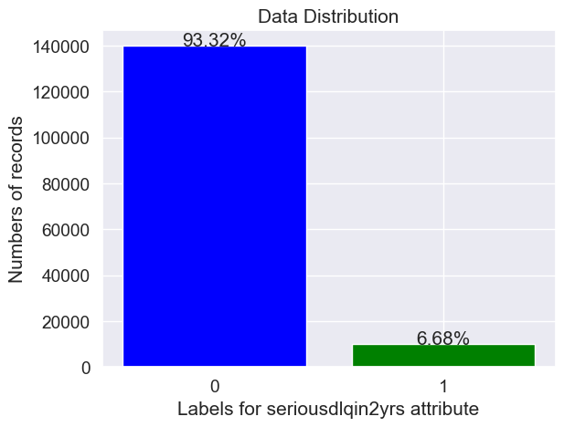
STAT3011
project replication
March 26 , 2024
Imbalanced Dataset
STAT3011_2324_GP10/Kelvin/stat3011 project2 eda p1.ipynb/line37
“Classifers may perform poorly on the minority class”​
Notes:
In our dataset, only a minority of the borrowers has experienced past dues of more than 90 days in the previous 2 years. This may reflect real-world situation. However, it is not a good situation for training machine learning classifier.​
[Doc]
STAT3011_2324_GP10/Kelvin/stat3011 project2 eda p1.ipynb/line37

Slide 11
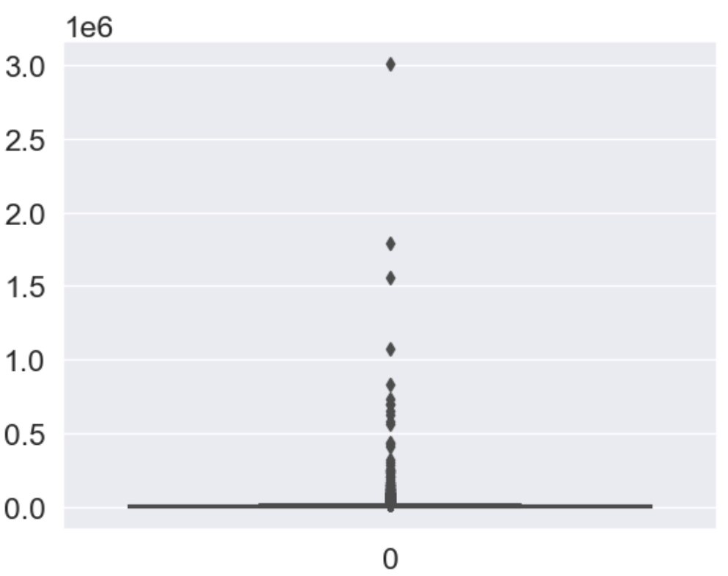
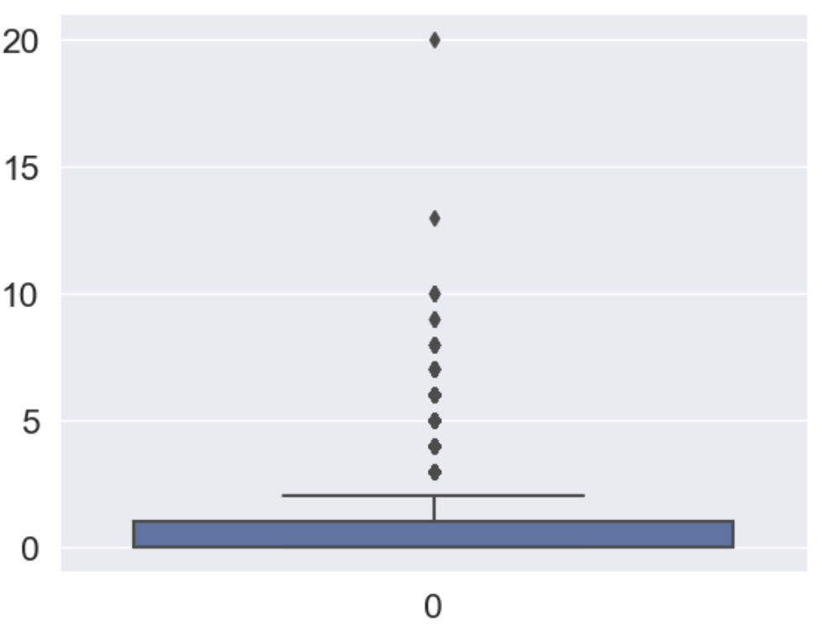
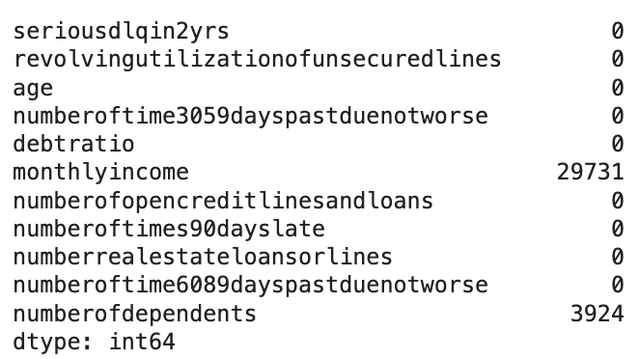
STAT3011
project replication
March 26 , 2024
Handling missing value
Column with NA
Boxplot of monthly income
Boxplot of number of dependents
“Determined to input missing value with median”
STAT3011_2324_GP10/Steven(CHEONG Euikyun)/Credit Risk Analysis_euikyun.ipynb/line322 - 329
Notes:
I will talk about how to detect outliers, but before this, I will replace the null value by median so that outlier can be detected correctly.
So, why replace null values with median, not mean?
By analyzing the boxplot below in [monthly_income] and [numberofdependents] plot, we can observe that there are multiple outliers above the 3rd quartile. Replacing the missing values with the mean in this case is not a great idea, since the resulting mean will be skewed due to the significant amount of outliers.
Using the median, a location-based statistic, makes much more sense in this case.
[Doc]
STAT3011_2324_GP10/Steven(CHEONG Euikyun)/Credit Risk Analysis_euikyun.ipynb/line322 - 329

Slide 12
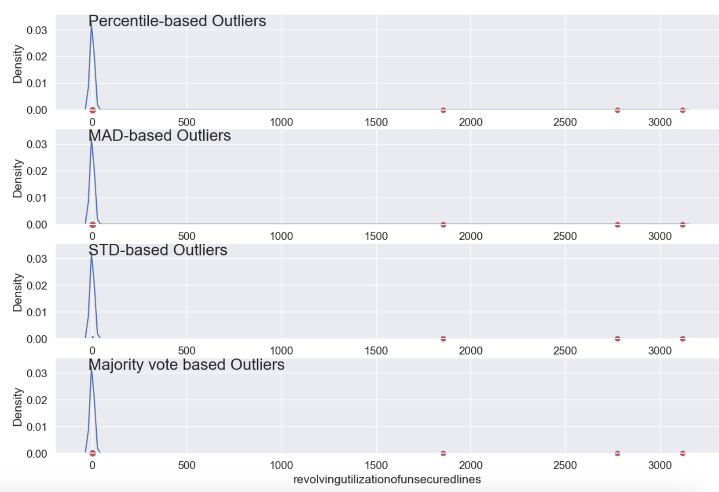
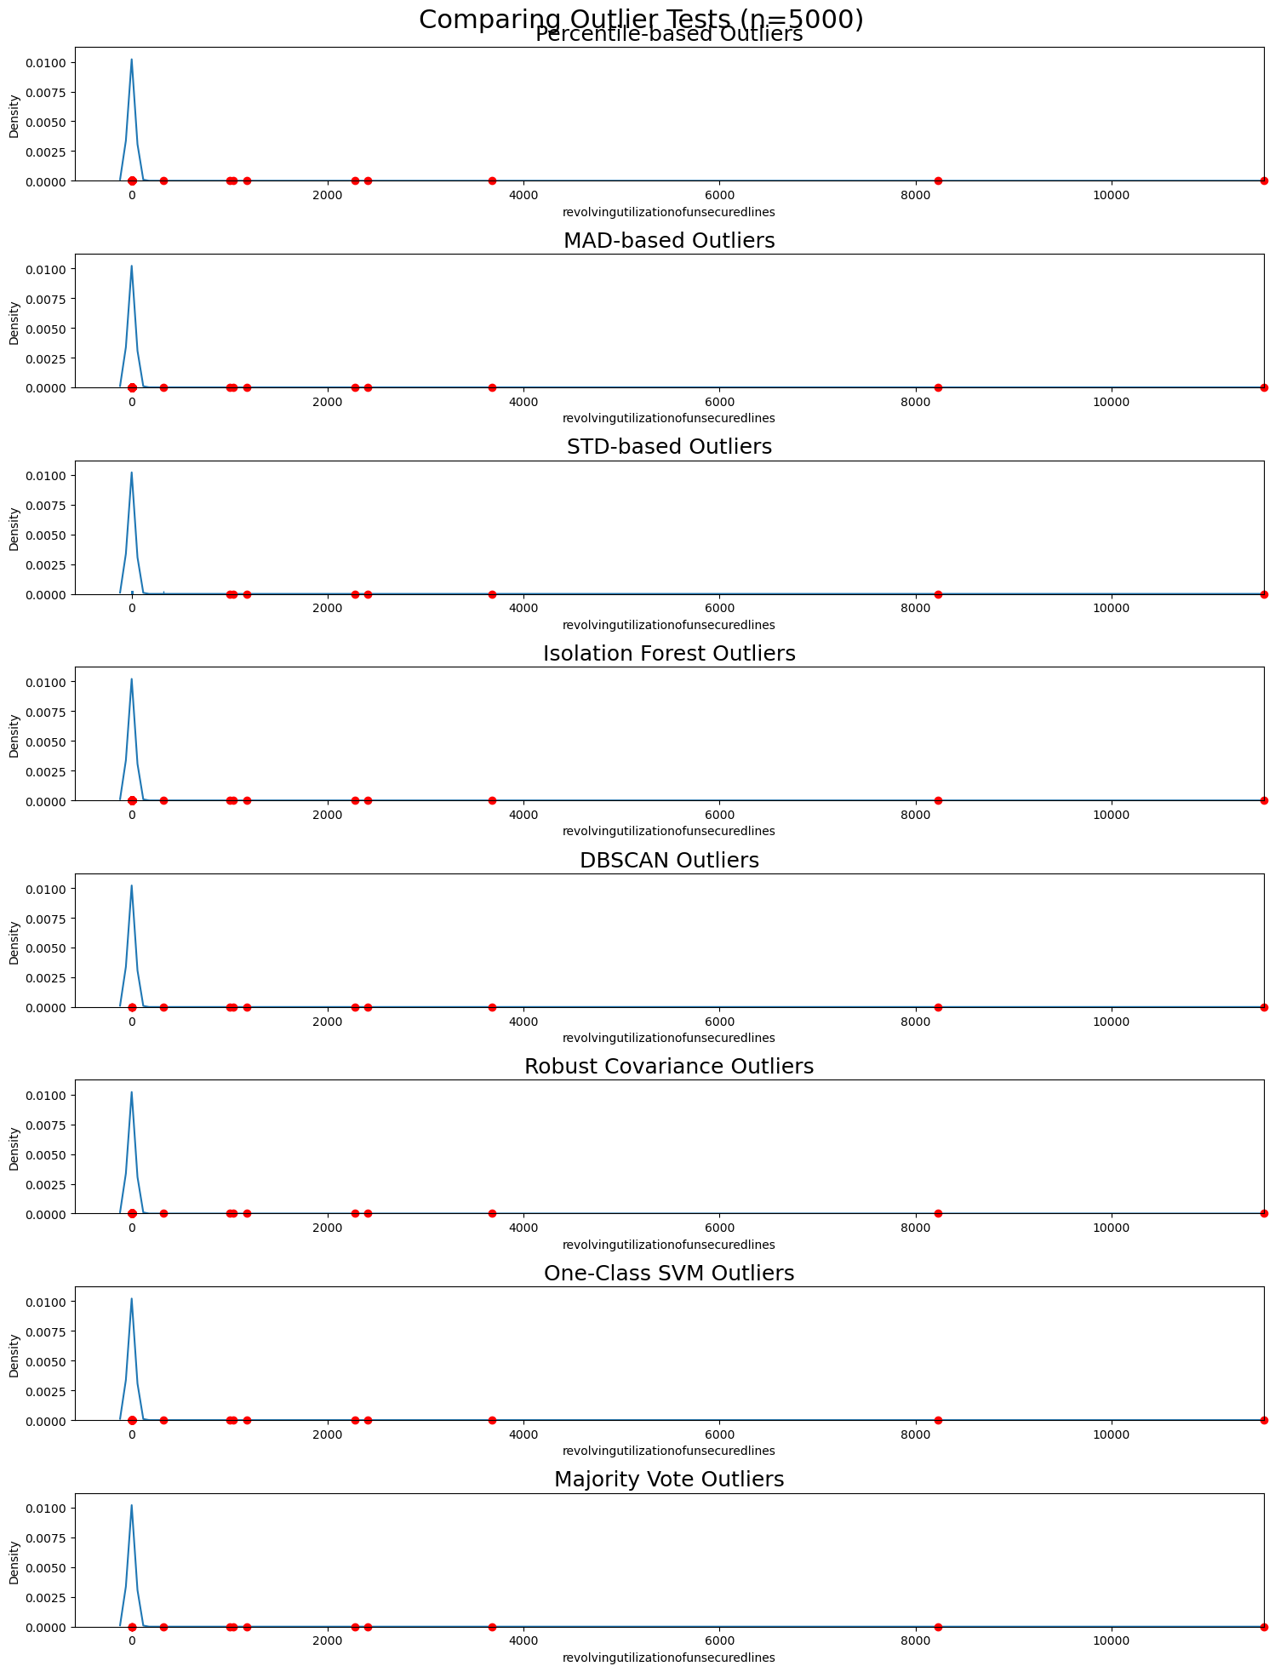
STAT3011
project replication
March 26 , 2024
Outlier Detection Method
STAT3011_2324_GP10/Edward/Credit Risk Analysis Original Version.ipynb/line17-23
STAT3011_2324_GP10/Edward/new basic_data_analysis Edward.ipynb/line 493-503
The outlier detection plot could be different because this plot is generated by sampling 5000 from the raw data
Notes:
Now, I will talk about the new outlier detection methods that can be used to detect outliers. One of the original methods, which is the majority vote based outlier on the left hand side, is renewed to the right hand side version.The renewed version is generated with the combinations of the 7 outlier detection methods.
STAT3011_2324_GP10/Edward/Credit Risk Analysis Original Version.ipynb/line17-23
STAT3011_2324_GP10/Edward/new basic_data_analysis Edward.ipynb/line 493-503

Slide 13
STAT3011
project replication
March 26 , 2024
New Outlier Detection Method
Isolation Forest
Using binary tree methods
Unique properties > outliers
Density Based Spatial Clustering of Applications with noise(DBSCAN)
Group data to point
Low density > outliers
STAT3011_2324_GP10/Edward/new basic_data_analysis Edward.ipynb/line 493-503
Notes:
The first method is Isolation tree, it is applying the binary tree methods. The program will randomly select difference samples, and define the common properties as a point from the sample. Then the program will calculate the distance from the point to each element, long distance travelled to the point will be defined as outlier by the program.
The second method is density Based Spatial Clustering of Applications with noise, it is defining outliers based on density. The model will find several core points in a high density area which have many nearby neighbors. Imagine many circles created with the core point is center, data that are not in any circles will be defined as outliers.
STAT3011_2324_GP10/Edward/new basic_data_analysis Edward.ipynb/line 493-503

Slide 14
STAT3011
project replication
March 26 , 2024
New Outlier Detection Method
3. Robust covariance method
Calculate the covariance matrix
Compare the covariance between each variable
4. One-Class Support Vector Machine
From database define a margin base on training data
Out of margin > Outlier
STAT3011_2324_GP10/Edward/new basic_data_analysis Edward.ipynb/line 493-503
Notes:
The third method is Robust covariance method, it is to detect the outlier by calculating the covariance matrix and comparing the covariance between each variable. Having low covariance with many variables will be defined as outliers.
The fourth method is One-Class Support Vector Machine, it will set a margin based on training data, for datapoints out of the margin, it will be defined as outliers.
STAT3011_2324_GP10/Edward/new basic_data_analysis Edward.ipynb/line 493-503

Slide 15
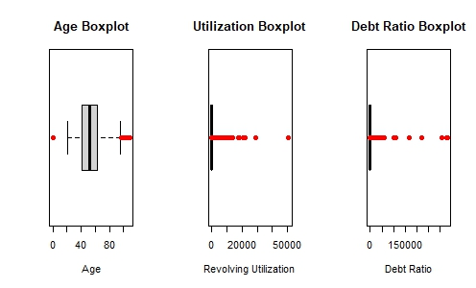
STAT3011
project replication
March 26 , 2024
Boxplot with Outlier
R boxplot.stats function to define outlier
Data points lie further the extreme of boxplot>outlier
STAT3011_2324_GP10/Edward/STAT3011 Edward.R/line 1-20
Notes:
Finally, I used the R programming build-in function boxplot.stats function to define outlier,data points that lie further the extreme of boxplot will be defined as outlier.
STAT3011_2324_GP10/Edward/STAT3011 Edward.R/line 1-20

Slide 16
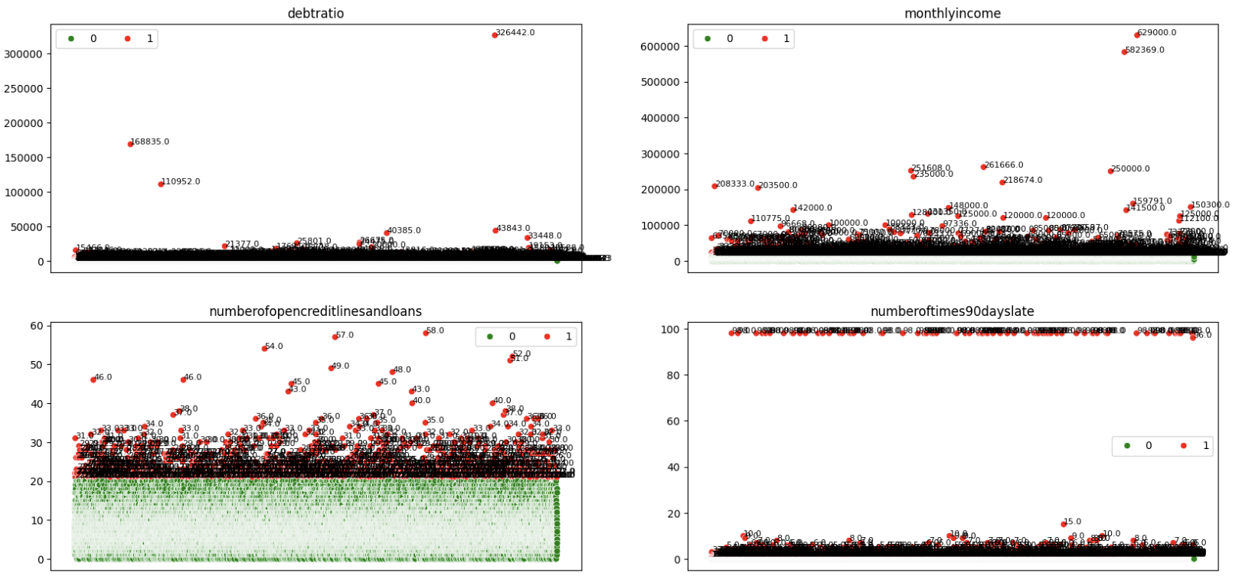
STAT3011
project replication
March 26 , 2024
Outlier Detection Method
Source : STAT3011_2324_GP10/Seokhyeon/data_preprocessing.ipynb/In[12]
Notes:
For this plot, we approached differently to recognize the whole feature’s outliers at once. Through this plot, we can identify the outliers more easily.
[Doc]
STAT3011_2324_GP10/Seokhyeon/data_preprocessing.ipynb/line12

Slide 17
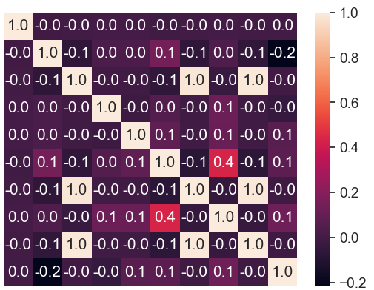
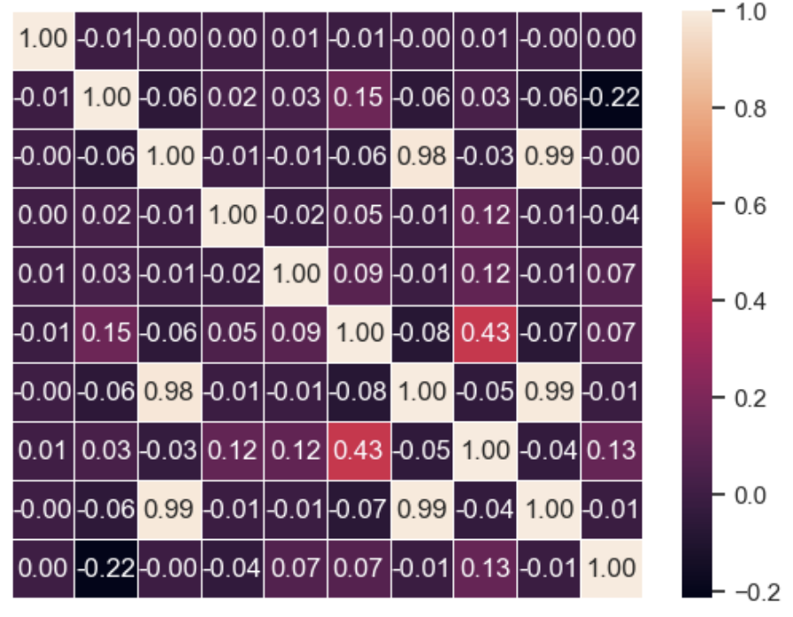
STAT3011
project replication
March 26 , 2024
Correlation Interpretation
revolvingutilizationofunsecuredlines
age
beroftime3059dayspastduenotworse
debtratio
monthlyincome
numberofopencreditlinesandloans
numberoftimes90dayslate
numberrealestateloanorlines
beroftime6089dayspastduenotworse
numberofdependents
STAT3011_2324_GP10/Hans/Credit Risk Analysis_RevisedVer.ipynb/line104
Notes:
Now, i am going to interpret the correlation between the variables. As you can see, some of the variables show that the correlation is 1. However, actually, this is not the 1, when we adjust the digit. The attributes [numberoftimes90dayslate], [numberoftime6089dayspastduenotworse], and [numberoftime3059dayspastduenotworse] are all nearly(but not perfectly) correlated with each other. Makes sense, since if someone has paid an EMI 90 days late then he would likely also have made other payments 60-89 or 30-59 days late.
The attributes [numberrealestateloansorlines] and [numberofopencreditlinesandloans] have a significant correlation of 0.43 worth noting. We will investigate this further in the model evaluation step later to see if this bears any significance to our resulting models.
[Doc]
STAT3011_2324_GP10/Hans/Credit Risk Analysis_RevisedVer.ipynb/line104

Slide 18
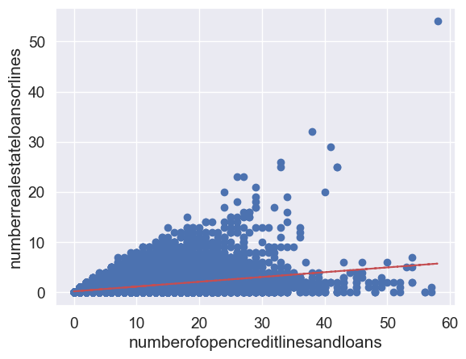
STAT3011
project replication
March 26 , 2024
Two-variable correlation(trends)
STAT3011_2324_GP10/Kelvin/stat3011 project2 eda p1.ipynb/line54
Notes:
To get a further look at the two variables, We’'ve plotted a scatter plot and a trendline of the two variables. The slope of the trend line is 0.4, so it's not a steep rise in absolute terms, but it's a noticeable correlation relative to the other variables. Also, since the slope is 0.4 even with the outlier in the upper right, wepredict that you'll have a higher correlation when dealing with the outlier.
[Doc]
STAT3011_2324_GP10/Kelvin/stat3011 project2 eda p1.ipynb/line54

Slide 19
STAT3011
project replication
March 26 , 2024
Handling outliers
Utilization of unsecured lines
> 0.9999 to 0.999
Age
< 21 to 21
Number of real estate loan or lines
> 17 to 17
Number of dependents
> 10 to 10
Check Distribution -> Manual Replacement
Notes:
Let’s have a look at how the original notebook handles the outliers. We can divide it into two methods, the first is this slide as you may see. After checking the distribution of the features listed above, the author sets his own threshold beyond which he perceives as an outlier. For example, for number of dependents, he sets a threshold of 10, and anything over 10 is replaced by 10. This may be a bit too subjective and we aim to have a more systematic logic behind the reasoning of our methods.

Slide 20
STAT3011
project replication
March 26 , 2024
Handling outliers
Number of days past due not worse
Outliers 96 & 98 to Median
Monthly Income
Voting-based
Debt ratio
Mean Absolute Deviation
Number of open credit lines and loans
N/A
Methods are different on each variable!
Notes:
The second way the author handles outliers is using a mix of different techniques. In the notebook, the author uses 3 methods: percentile, standard deviation, and mean absolute deviation for detecting outliers. After which, a majority vote is held so that if 2 or more of the stated methods decide a point is an outlier, then it is applied, otherwise it is not. This is the case for the feature ‘monthly income’. As you may see, it can get a bit confusing. The author also did not address why the last feature, ‘number of open credit lines and loans’, does not need any outlier removal.

Slide 21
STAT3011
project replication
March 26 , 2024
Handling outliers: Our methods
Number of dependents
z score method
Monthly Income
Winsorization
Number of times 90 days late
z score method
Number of open credit lines and loans
IQR method
Methods are different on each variable!
Notes:
Now let’s move on to our methods. There are in total 3 methods, including winsorization, z score method and IQR method. We apply different techniques on different variables. We will go over each of them 1 by 1.

Slide 22
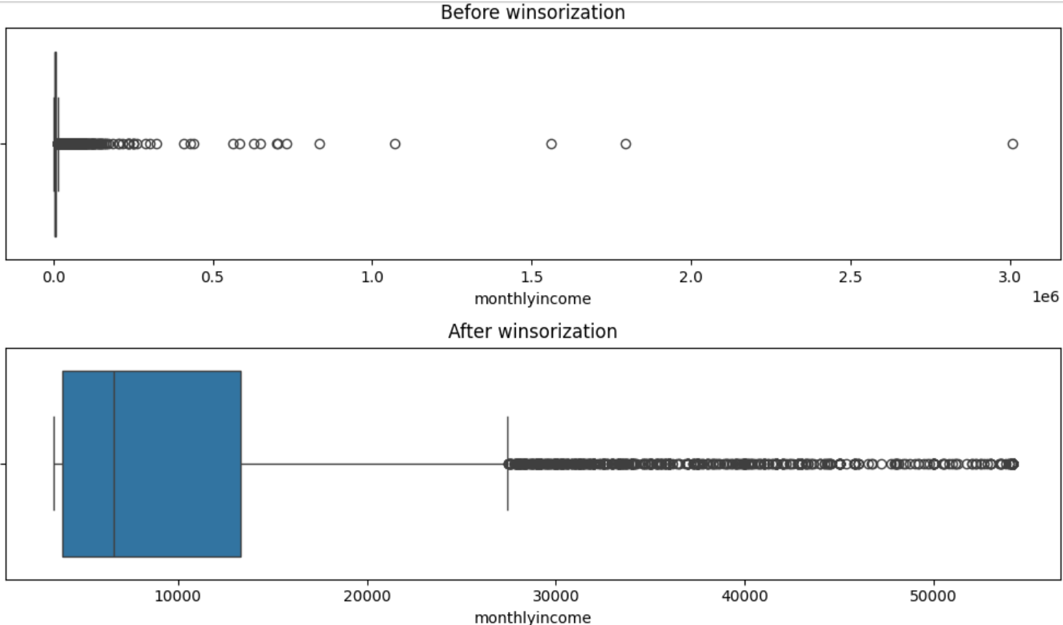
STAT3011
project replication
March 26 , 2024
Winsorization
Replace the bottom x% of data with the x th percentile
Replace the top y% of data with the y th percentile
Drawback: Loss of data
STAT3011_2324_GP10/Aiden/stat3011part2.modified.ipynb/line269
Notes:
The 1st method is winsorization. As you can see, this method is just about replacing outliers with less extreme data. In this case, the lowest 20% of data were all replaced by the 20th percentile, while the top 20% of data were all replaced by the 80th percentile.
Before applying this method, we can see that there are some data with monthly income > 1 million. After winsorization, outliers are gone. The most extreme data is much closer to the median.
The drawback is that we lost a lot of information. In this case,40% of data are lost. There should be other methods!
[Doc]
STAT3011_2324_GP10/Aiden/stat3011part2.modified.ipynb/line269

Slide 23
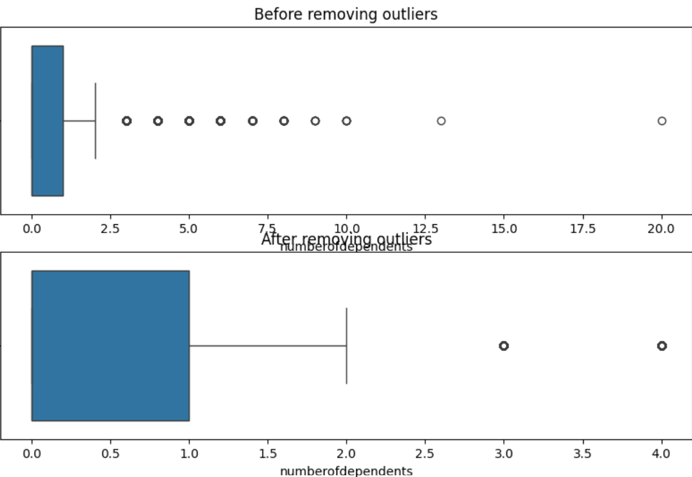
STAT3011
project replication
March 26 , 2024
Z score method
Data which have z score < -x or > x are removed
x=3 is chosen in this case
Drawback: Not follow normal distribution >- may not be suitable
‘Number of dependents’ is right skewed
STAT3011_2324_GP10/Aiden/stat3011part2.modified.ipynb/line275
Notes:
The 2nd method is z-score method. It is comparatively easier to understand: data with z score larger or smaller than some values are removed. We chose x=3 in this case. After applying it, outliers like 13, 20 are all gone. This method assumes that the data is normally distributed, but the variable ‘number of dependents’ is obviously right skewed. Is this method not good?
[Doc]
STAT3011_2324_GP10/Aiden/stat3011part2.modified.ipynb/line275

Slide 24
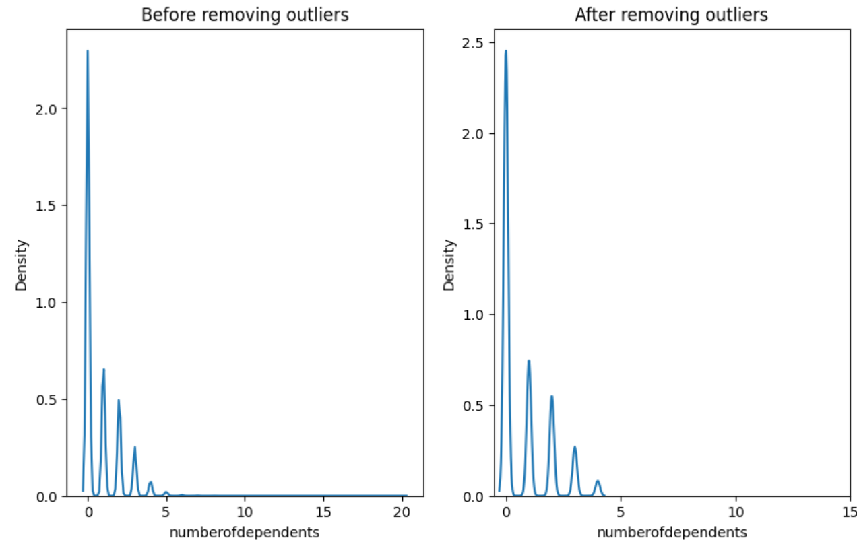
STAT3011
project replication
March 26 , 2024
Z score method
STAT3011_2324_GP10/Aiden/stat3011part2.modified.ipynb/line276
The distribution of the data doesn’t change!
Notes:
Even though ‘number of dependents’ doesn’t follow normal distribution, using kde plots, we can see that the distribution of the data doesn’t change after removing the outliers!
[Doc]
STAT3011_2324_GP10/Aiden/stat3011part2.modified.ipynb/line276

Slide 25
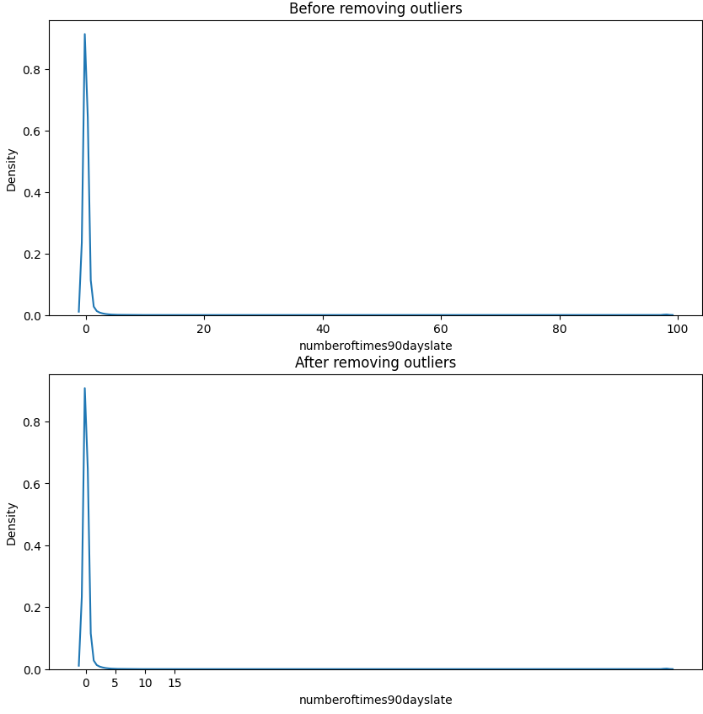
STAT3011
project replication
March 26 , 2024
Z score method
STAT3011_2324_GP10/Aiden/stat3011part2.modified.ipynb/line284
The distribution of the data also doesn’t change!
Notes:
The same is also true if we try another variable, which is ‘number of times 90 days late’
[Doc]
STAT3011_2324_GP10/Aiden/stat3011part2.modified.ipynb/line284

Slide 26
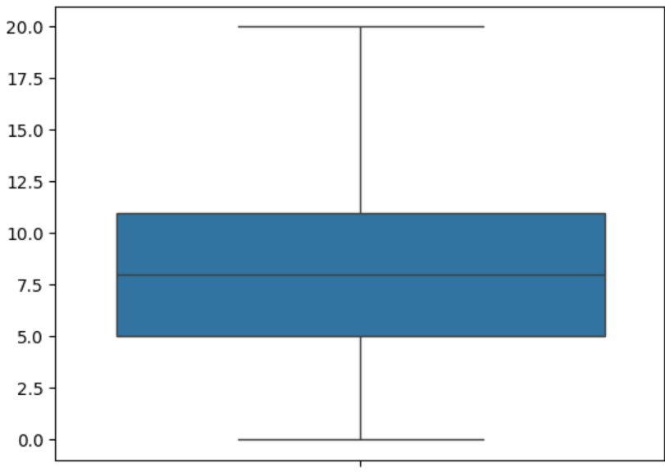
STAT3011
project replication
March 26 , 2024
IQR method
All the data < mean-1.5IQR or >mean+1.5 IQR are removed
Doesn’t require normal distribution
Data > 20 are removed, similar to what textbook’s methods did
STAT3011_2324_GP10/Aiden/stat3011part2.modified.ipynb/line279
Notes:
The last method is IQR method. We apply this to the ‘number of open credits and loans’ variable. All the data which are larger than mean +1.5 IQR or smaller than mean- 1.5 IQR are removed. Unlike the previous method, it doesn’t require normal distribution. In this case, data > 20 are removed. It does the same as most of textbook’s methods. That’s the end of EDA part, let’s move on to machine learning modeling.
[Doc]
STAT3011_2324_GP10/Aiden/stat3011part2.modified.ipynb/line279

Slide 27
STAT3011
project replication
March 26 , 2024
Machine learning modeling
KNN Clustering
Logistic Regression
Adaboost Classifier
a supervised machine learning algorithm used for classification tasks. It assigns a new data point to the majority class among its k nearest neighbors, where k is a user-defined parameter.
a statistical model used for binary classification tasks. It estimates the probability of an input belonging to a particular class by applying a logistic function to a linear combination of input features.
is a boosting algorithm used for binary classification tasks. It combines multiple weak classifiers into a strong classifier by iteratively adjusting the weights of the training samples based on their classification performance.
Gradient
Boosting Classifier
Random Forest
Classifier
Vote Ensemble Classifier
a machine learning algorithm that combines weak predictive models, typically decision trees, to create a strong predictive model. It works by iteratively training new models that focus on the errors made by previous models and then combining their predictions through a weighted sum.
an ensemble learning algorithm that combines multiple decision trees to make predictions. It works by constructing a multitude of decision trees during training and then using a voting mechanism to aggregate their predictions.
an ensemble learning algorithm that combines the predictions of multiple individual classifiers to make a final prediction. Each individual classifier is trained independently on the same training data, using different algorithms or settings.
Notes:
Now, we will reach the modeling stage of our project. Here we use these algorithms, KNN Clustering, Logistic Regression, Adaboost, Gradient Boosting, and Random Forest. KNN works by assigning a new data point to the majority class among its K nearest neighbours. Logistic Regression and Adaboost is used for binary classification. Gradient boosting combines weak predictive models with a weighted sum and iteratively trains new models that emphasize the errors made by previous models. Random forest combines many decision trees to make predictions. Similarly, vote ensemble classifiers does the same with a majority vote.

Slide 28
STAT3011
project replication
March 26 , 2024
Machine learning modeling
Model | Accuracy | ROC_AUC score
KNN classifier | 0.9314 | 0.5896
Logistic Regression | 0.9363 | 0.8502
Adaboost Classifier | 0.9354 | 0.8584
Gradient Boosting Classifier | 0.9360 | 0.8631
Random Forest Classifier | 0.9318 | 0.7801
Notes:
Here are the results obtained from fitting the models naively. As you can see, it boasts a pretty high accuracy, and some of them have good ROC_AUC scores, which is an measure of how well a binary classifier is working towards correctly predicting classes. The higher the ROC score, the better it is, with a maximum of 1 for a perfect classifier.

Slide 29
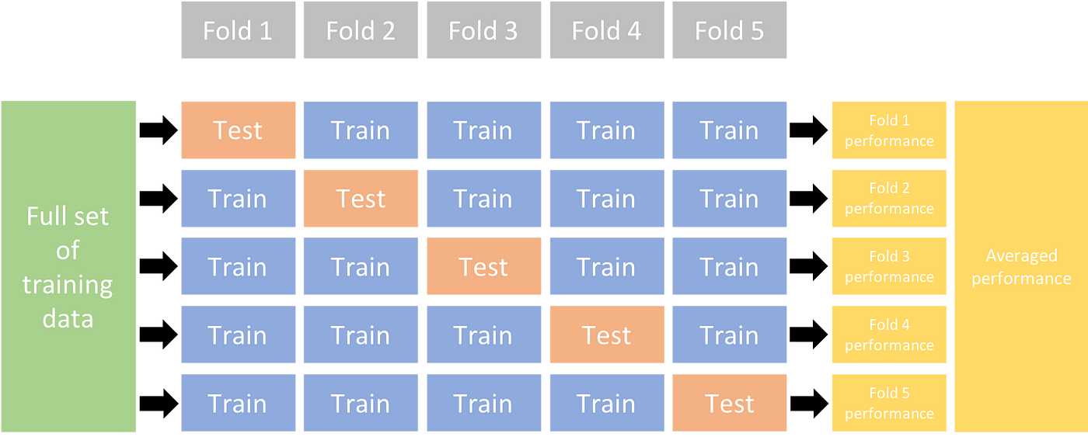
STAT3011
project replication
March 26 , 2024
Cross validation
“With cross-validation, we can avoid overfitting and derive more liable score of the model”
Notes:
After training and fitting the models, we use a well-known method called cross-validation. Simply put, we divide our full set of training data into several folds, in this case, lets say 5 folds. So, now our data is divided into 5, then we assign one of them to be the test set, and the other 4 into the train set. We then repeat so that in each of our fold, there is a unique test set, so that each subsection of our data is the test set on one of the folds. Using the other 4 to train it, we evaluate it on this test set. Finally we average the score across all of the folds to obtain the final score. Cross validation is useful to avoid overfitting.

Slide 30
STAT3011
project replication
March 26 , 2024
Cross validation
KNeighborsClassifier | 0.5960
Logistic Regression | 0.8494
AdaBoost Classifier | 0.8586
GradientBoostingClassifier | 0.8639
RandomForest Classfier | 0.7774
0.3354
0.6009
0.0768
0.0721
0.1544
Notes:
Here are the final scores of the models after cross validating. Notice that there is a small decrease when cross validating, and that the adabosst and gradientboosting classifier has performed the best in terms of accuracy.

Slide 31
STAT3011
project replication
March 26 , 2024
Hyperparameter tuning & Feature transformation
Adaboost model hyperparameter tuning
params | option 1 | option 2 | option 3 | option 4
learning rate(added) | 1 | 0.1 | 0.01
n_estimator | 10 | 50 | 100 | 420
Applied log on the X_test data
Gradient Boosting model hyperparameter tuning
params | option 1 | option 2 | option 3 | option 4
loss | deviance | exponential
n_estimator | random integer between 10 and 500
max_depth | randome integer between 1 and 10
Notes:
Afterwards, we use a function called randomsearch and gridsearch to tune the hyperparameters automatically. The function automatically searches across the range of hyperparameters we give to it to find the best possible score, in this case, accuracy, of the model. Afterwards, we apply log transformation on the X_test data to…

Slide 32
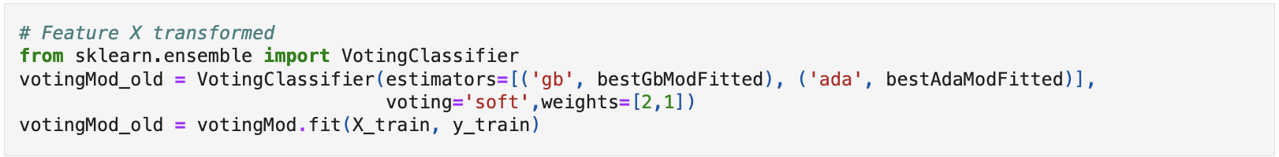
STAT3011
project replication
March 26 , 2024
Vote ensemble model
estimators = [..]
Two models are used: bestGbModFitted_transformed
and bestAdaModFitted_transformed
voting=’soft’
Soft voting is used, meaning the predictions will be based on the average probabilities from both models
weights=[2,1]
Assigns different weights to the models, giving twice as much importance to the predictions from the first model compared to the second one
Notes:
Finally, using our best tuned models of adabosst and gradientboosting, we use the aforementioned vote ensemble model in a an attempt to further increase our scores. We use a soft voting, meaning we average the probabilities of the two models, however we assign twice as much weight to the gradient boosting model compared to ada boost to reflect their importance. This is something we have experimented with.

Slide 33
STAT3011
project replication
March 26 , 2024
Results
Model | Accuracy | ROC_AUC score
KNN classifier | 0.9314 | 0.5896
Logistic Regression | 0.9363 | 0.8502
Adaboost Classifier | 0.9354 | 0.8584
Gradient Boosting Classifier | 0.9360 | 0.8631
Random Forest Classifier | 0.9318 | 0.7801
Vote ensemble Classifier | 0.93576 | 0.8643
Notes:
As you may see, the vote ensemble classifier gave us the best roc score of 86.4% at last, which is a good increase compared to just gradient boosting or adaboost alone.

Slide 34


STAT3011
project replication
March 26, 2024
Why is recall important in credit risk?
PRECISION
Of all people predicted to default, how many will actually default?
FALSE POSITIVES 🠋 PRECISION 🠉
RECALL
Of all real defaults, how many are correctly predicted to default?
FALSE NEGATIVES 🠋 RECALL 🠉
Choosing to lend money to someone that will default will lose us a lot of money!
We aim to reduce FALSE NEGATIVES to increase RECALL !
Notes:
Why is recall important in credit risk? Firstly, precision and recall are metrics commonly used for classification. Precision concerns us with the question of how many people will actually default according to the target value, out of everyone predicted to default with our model? The lower the false positives are, that is, the more people that will default based on our model’s prediction, the higher the precision. Recall however, asks us out of everyone that will actually default, how many have we correctly predicted with our model? In our case, lending money to someone we know will default will cost us a lot of money since they cannot pay it back. So it is clear in this case that we focus more on recall than precision, aiming to reduce falsely identifying someone as ‘not going to default’, even if doing so means we will sacrifice our precision.

Slide 35
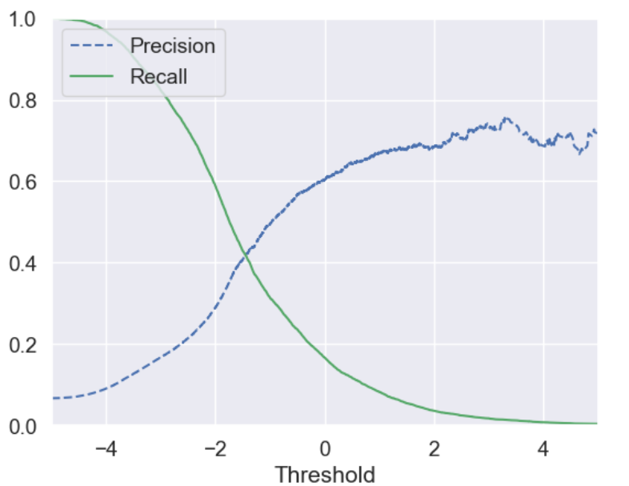
STAT3011
project replication
March 26 , 2024
Precision-Recall Curve
STAT3011_2324_GP10/Hans/Credit Risk Analysis_euikyun.ipynb (line 247)
Notes:
Looking at the precision-recall curve, we may choose the right threshold value of the x-axis to provide the best recall and precision score. Since recall is more important we may choose values from the left rectangle, obtaining higher recall but lower precision, in our case it is better to do so.
The same is also true if we try another variable, which is ‘number of times 90 days late’
[Doc]
STAT3011_2324_GP10/Hans/Credit Risk Analysis_euikyun.ipynb (line 247)

Slide 36
STAT3011
project replication
March 26 , 2024
Results
Model | Precision | Recall | ROC_AUC score
Adaboost Classifier | 12.69% | 91.28% | 85.66%
Gradient Boosting Classifier | 13.69% | 99.95% | 86.24%
Negligible difference in overall ROC_AUC score
Increase recall to >90% at the cost of precision!
Notes:
If we do that method for our two best classifiers from before, we can select recall of above 90% to ensure we don’t lose too much money from misclassifying default as non-default customers. We observe very little difference in overall ROC score, but also notice that due to the nature of the dataset, increasing recall comes at hte price of precision. We will discuss this later in the external data part.

Slide 37

STAT3011
March 26, 2024
Model Improvements
Notes:
So, now i’m going to present how we improved to get better recall score.
In the context of fraud detection, missing actual fraudulent transactions, false negatives, can be much more costly and harmful than falsely flagging legitimate transactions as fraud, false positives. A high recall ensures that the model can identify as many actual fraudulent cases as possible, reducing the chances of overlooking fraudulent activities.

Slide 38
STAT3011
Model Improvements
March 26 , 2024
How to improve the score of model?
Handle outlier differently
No outlier handling
Take log to the column
Fit into IQR
Delete the outliers
Deleting variables with high correlation
Drop the null value
Apply different machine learning model
Catboost model
Use Gradient Boosting model
Notes:
So we came up with 4 different approach to improve our model. The first approach is to handle outliers differently. We tried 4 different ways to handle outliers differently before other approach cuz we thought outliers play significant role to our model. We first did nothing to outliers to set the standard and took log to every features and also fit into iqr and removed all the outliers. We also tried to drop the null values. The first three approach was trained by our best performing model, which was gradient boosting. Lastly, we applied different machine learning model, which is catboost model.
So, we can divide our improvments into 4 parts. Firstly, we mainly focused on preprocessing the dataset. Taking log to the column, applying different outlier standards, deleting outliers, and just don’t do anything for outlier handling. Secondly, we tried to delete the variables with the high correlation. If the high correlated variables are significant for the model, it could give better result. But, if is not, it could make model worse. Third, we tried to drop the null value. The first 3 approach will be proceeded our best model which is gradient boosting method. And lastly, we will try to apply different machine learning model to make some result.

Slide 39
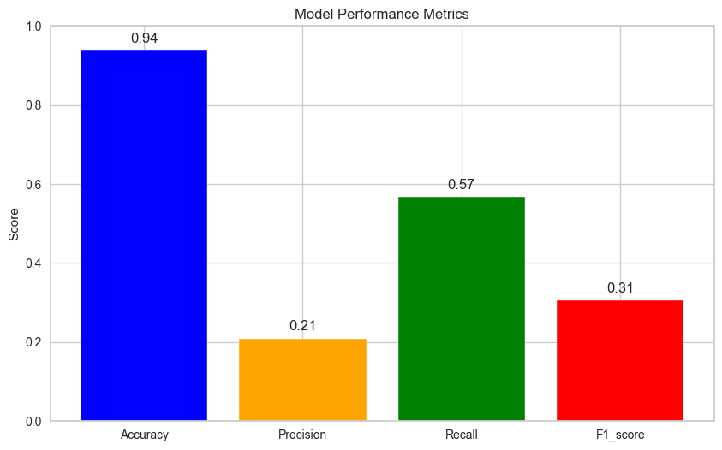
STAT3011
Application of external data
March 26 , 2024
No outlier handling
STAT3011_2324_GP10/Steven(CHEONG Euikyun)/Credit Risk Analysis_OutlierX.ipynb/ln[29]
Notes:
This is the result of gradient boosting without any outlier handling. We can see that recall score is over 50%.
STAT3011_2324_GP10/Steven(CHEONG Euikyun)/Credit Risk Analysis_OutlierX.ipynb/ln[29]

Slide 40
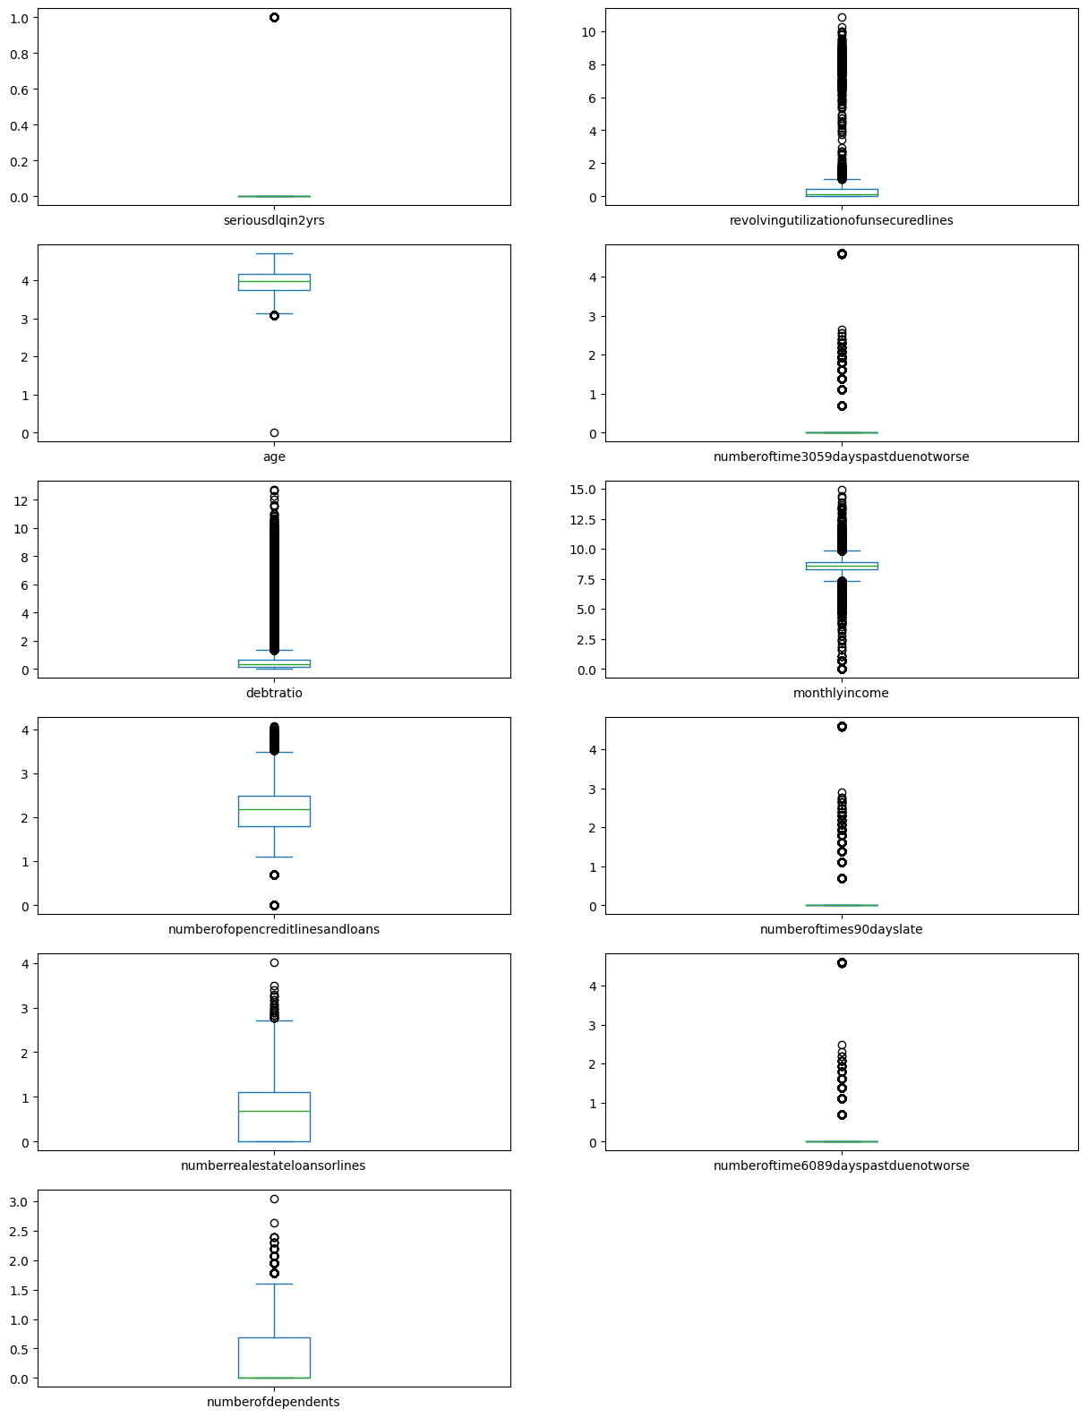
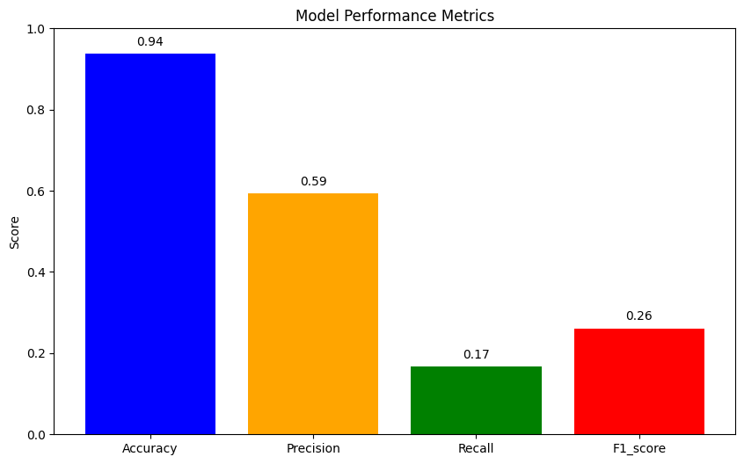
STAT3011
Application of external data
March 26 , 2024
Log application
Source : STAT3011_2324_GP10/Seokhyeon/Credit Risk Analysis_log_all_gb.ipynb/In[50]
Source : STAT3011_2324_GP10/Seokhyeon/Credit Risk Analysis_log_all_gb.ipynb/In[26]
Notes:
his is the score of gradient boosting with log-applied to every features. We can see that precision is higher but the recall is very low. From the boxplot, we can see that the distribution is way less.

Slide 41
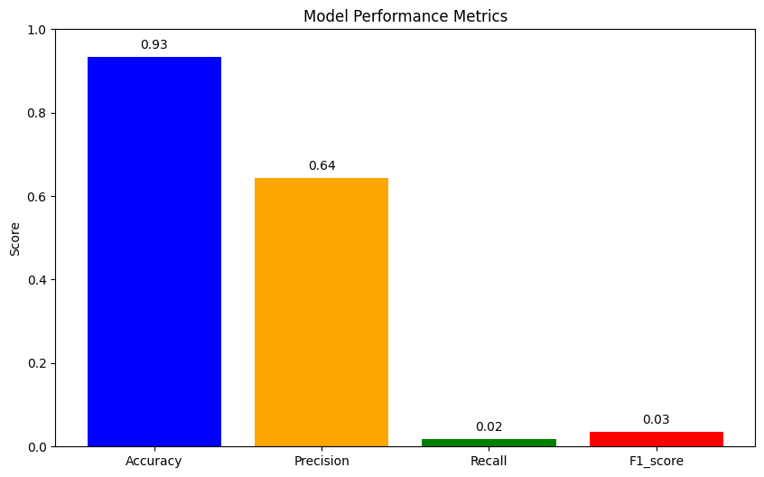
STAT3011
Application of external data
March 26 , 2024
Fit into IQR Range
Source : STAT3011_2324_GP10/Seokhyeon/Credit Risk Analysis_IQR_gb.ipynb/In[29]
Notes:
This is the result of fitting every outliers into IQR range. I set the boundaries from 25% to 75% and ran it with gradient boosting model. It is shown that recall and f1score is very low.

Slide 42
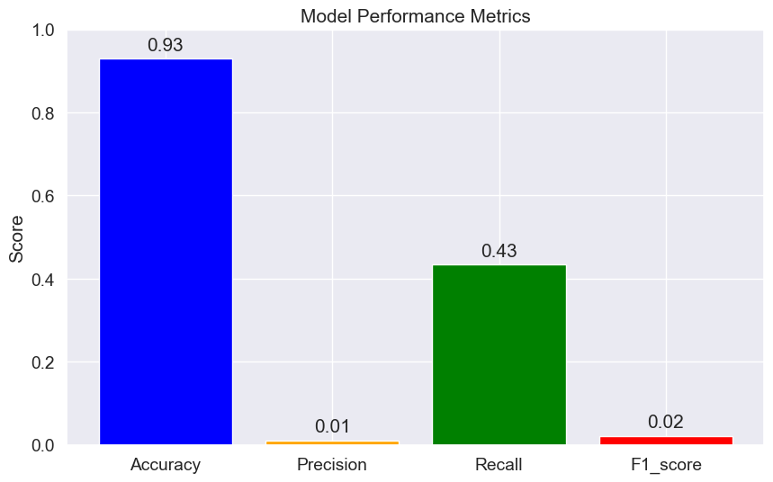
STAT3011
Application of external data
March 26 , 2024
Deleting high correlated variables
STAT3011_2324_GP10/Steven(CHEONG Euikyun)/Credit Risk Analysis_delete_column_with_high_corr.ipynb/ln[120]
Deleted variables :
'numberoftime3059dayspastduenotworse',
'numberoftimes90dayslate',
'numberoftime6089dayspastduenotworse'
Notes:
In this approach, we removed 3 highly correlated variables. This is because while we were researching, we have figured out that if the highly correlated features impacts the result, then it is ok to have such features. However, if they do not impact the result, they can make the whole model biased. Therefore, we decided to give it a try and recall was below 0.5 and f1 score was very low.
STAT3011_2324_GP10/Steven(CHEONG Euikyun)/Credit Risk Analysis_delete_column_with_high_corr.ipynb/ln[120]

Slide 43
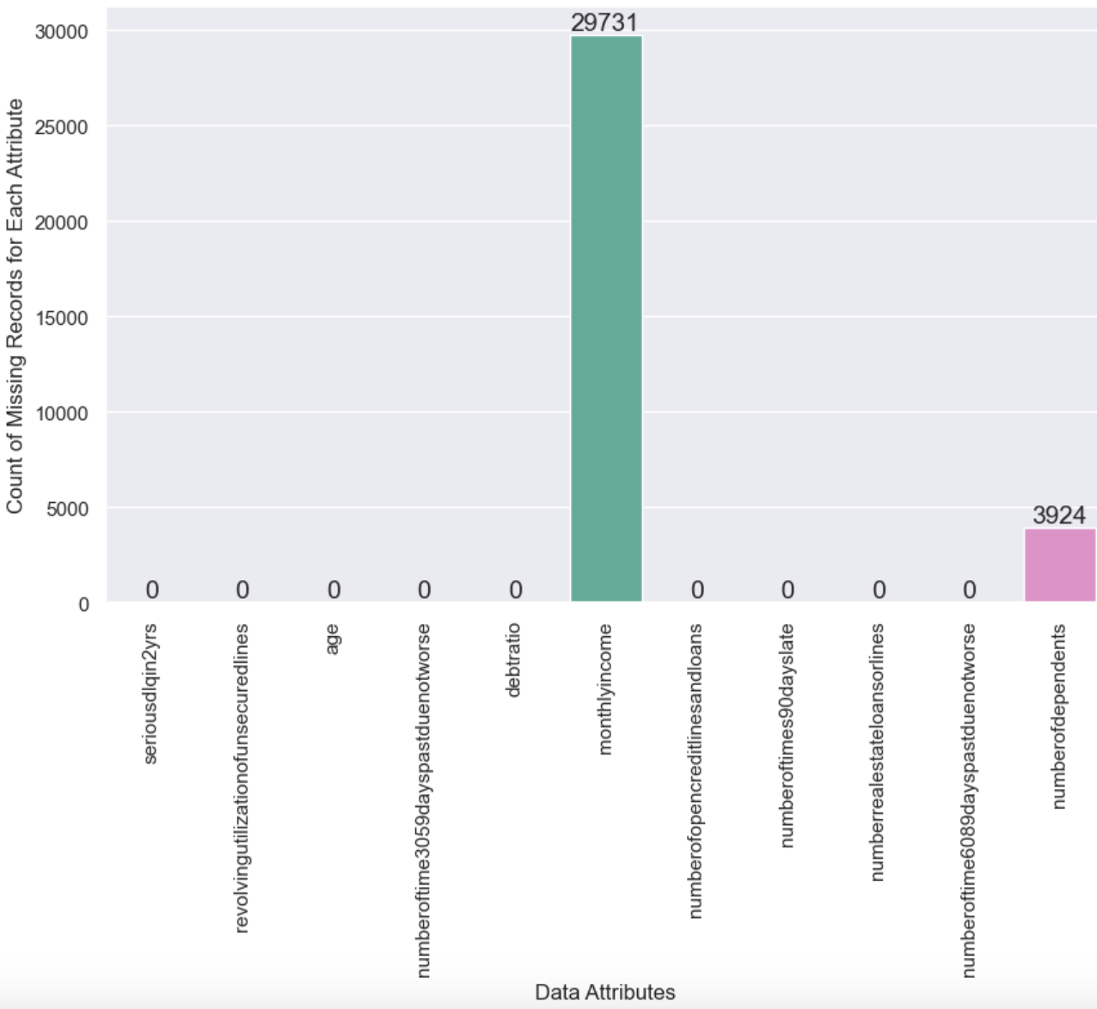
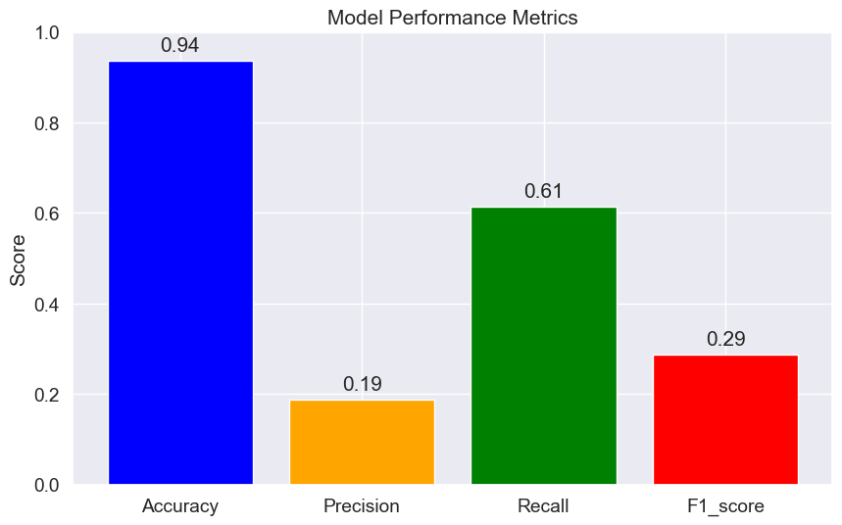
STAT3011
Application of external data
March 26 , 2024
Drop null value
STAT3011_2324_GP10/Steven(CHEONG Euikyun)/Credit Risk Analysis_dropNA.ipynb/ln[151]
Notes:
At this time, we decided to not only drop the null values but keep the outliers the way they are. When we ran the model, the recall was very high.
STAT3011_2324_GP10/Steven(CHEONG Euikyun)/Credit Risk Analysis_dropNA.ipynb/ln[151]

Slide 44
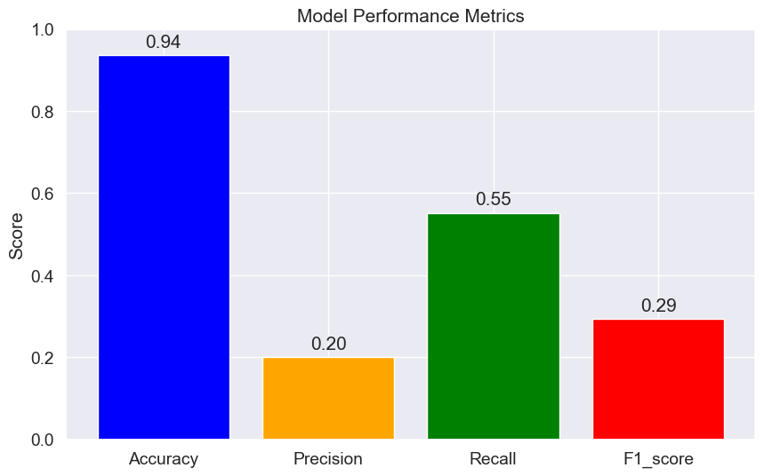
STAT3011
Application of external data
March 26 , 2024
Catboost Classifier (Apply other method)
STAT3011_2324_GP10/Steven(CHEONG Euikyun)/Credit Risk Analysis_Catboost_LGBM.ipynb/ln[159]
Notes:
We came up with a completely new model, which is a catboost classifier. Recall was 55% and the precision was 0.2.
STAT3011_2324_GP10/Steven(CHEONG Euikyun)/Credit Risk Analysis_Catboost_LGBM.ipynb/ln[159]

Slide 45
STAT3011
Application of external data
March 26 , 2024
Overview of the improvements
 | Accuracy | Precision | Recall | F1_score
Outlier : Log application | 0.94 | 0.59 | 0.17 | 0.26
Outlier : different outlier approach | 0.93 | 0.64 | 0.02 | 0.03
Outlier : No outlier handling | 0.94 | 0.21 | 0.57 | 0.31
Delete high correlate variables | 0.93 | 0.01 | 0.43 | 0.02
Drop null value | 0.94 | 0.19 | 0.61 | 0.29
Catboost Classifier | 0.94 | 0.20 | 0.55 | 0.29
Notes:
Overall, the accuracy was quite similar for each approach but dropping the null value showed significant increase in the recall score. It has the highest recall from the others. Therefore, we can conclude that the outliers played important role as of prediction and rather than replacing the na values, just removing the row was the best approach.

Slide 46
STAT3011
March 26, 2024
Application of
external data
Notes:
Now, i’m going to talk about the case of applying the methods and models to the external data.

Slide 47
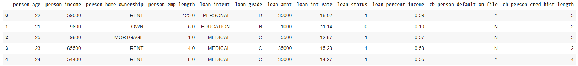
STAT3011
Application of external data
March 26 , 2024
External data overview
STAT3011_2324_GP10/Steven(CHEONG Euikyun)/Credit_risk_analysis_external_data.ipynb/line106
Data Source: Kaggle
Data Size: 32851
Variables: 12 ( 11 predictor variables + 1 response variable)
Each Data: the demographic of a person (e.g., ages, income, home ownership, loan grade and history, etc.)
Source : https://www.kaggle.com/datasets/laotse/credit-risk-dataset/data
Notes:
As we talked about before, we mentioned about the our dataset’s response variable had quite imbalance dataset, and that’s why thought the recall score wasn’t good enough. In this case, we tried to find dataset that have more discrete information and more percentage ratio in response variable. This dataset is sharing same topic credit risk analysis and the response dataset’s default ratio is higher than our original dataset. However, the total row is lower than our original dataset, which is 32851, containing with 12 columns with 11 predictor variables and 1 response variable. This data is from kaggle.
[Doc]
STAT3011_2324_GP10/Steven(CHEONG Euikyun)/Credit_risk_analysis_external_data.ipynb/line106

Slide 48
STAT3011
Application of external data
March 26 2024
Best Approachment
Null value handling
Outlier handling
Best Model
Hyperparameter tune
Replace with the median
Handled outlier based on the method used in original notebook.
Gradient boosting Model selected to be best model
Conducted hyperparameter tuning by using randomizedsearchcv
Categorical Variable
No categorical variable in original project
Handled by label encoding
Notes:
In this case, we simply chose the best approachment in our original notebook that derived the best score considering both accuracy and recall score. For null value handling part, we follow the median replacing same with the original notebook. As well as outlier handling, we followed the logic of the outlier handling. However, there was one thing wasn’t appeared on our original notebook is categorical variable handling. After the research, we decided to label encode the categorical variable. For the model, we chose gradient boosting model is best model among the models. And after we performed hyperparameter tuning by using randomizedSearchCV function.

Slide 49
STAT3011
Application of external data
March 26, 2024
Result
Accuracy | 0.922
Precision | 0.946
Recall | 0.681
F1_score | 0.792
Accuracy | 0.939
Precision | 0.96
Recall | 0.750
F1_score | 0.842
Before Hyperparameter tuning
After Hyperparameter tuning(CV=5)
STAT3011_2324_GP10/Steven(CHEONG Euikyun)/Credit_risk_analysis_external_data.ipynb/line125, 137
Notes:
This is the result of the modeling. The first table shows the score before the hyperparameter tuning and the second table shows the score after the hyperparameter tuning. Within this new external dataset, we can observe the higher recall score than before. As well as the score of the precision was higher than the result of the dataset. We could observe the significance of the dataset. Since the original dataset response variable’s default ratio was nearly 10 percent which make hard for predict. But, the increasement of the response’s variables ratio can able to result a better score.
[Doc]
STAT3011_2324_GP10/Steven(CHEONG Euikyun)/Credit_risk_analysis_external_data.ipynb/line125, 137

Slide 50
STAT 3011
Conclusion
March 26, 2024
Conclusion
Our group focused on the the score of recall to provide better prediction on real business model
Overally, dropping null values, following outlier handling of original notebook, and using gradient boosting machine model resulted best during our project because it achieved both high accuracy and relatively high recall score
Notes:
In conclusion, our group mainly divided the projects into 3 parts. Explanation of the original notebook, improvements, and application to the external dataset. At the first glance of the project, we had hard time understanding the intention of the original code writers, such as setting the specific number of outlier standard. But, we have found interesting while understanding the logic, and on the same time, we added some insights or improvements that we think that it would be better than the original notebook. Also, during on our research, by understanding the domain knowledge, we found that the recall score method is the significant scoring metrics in our problem. So, we thrived to improve the recall score by approaching various of improvements. Also, by applying the best approachment with the external dataset, we found the possible problem of the original dataset.

Slide 51
STAT 3011
Conclusion
March 26, 2024
Limitation
By referring the result of external data, we can find out that the overall scores were higher than our original project. We can expect that the external data had more categorical variable and abundant data. Also, the data was less imbalanced than the original dataset. Our group learned that the insufficient data could affect the score of dataset significantly
Notes:
So, we set those points as limitation. We was able to achieve good score on external dataset. But, imagine if the original notebook’s dataset is our business dataset, we might have problem on applying it in real business world problem. Therefore, our group learned that before applying to certain business problem, we need a really good source to make good quality products.
Thank you listening to our presentation. Thank you.

Slide 52

STAT 3011
End
March 26, 2024
Q & A

